Slide 1
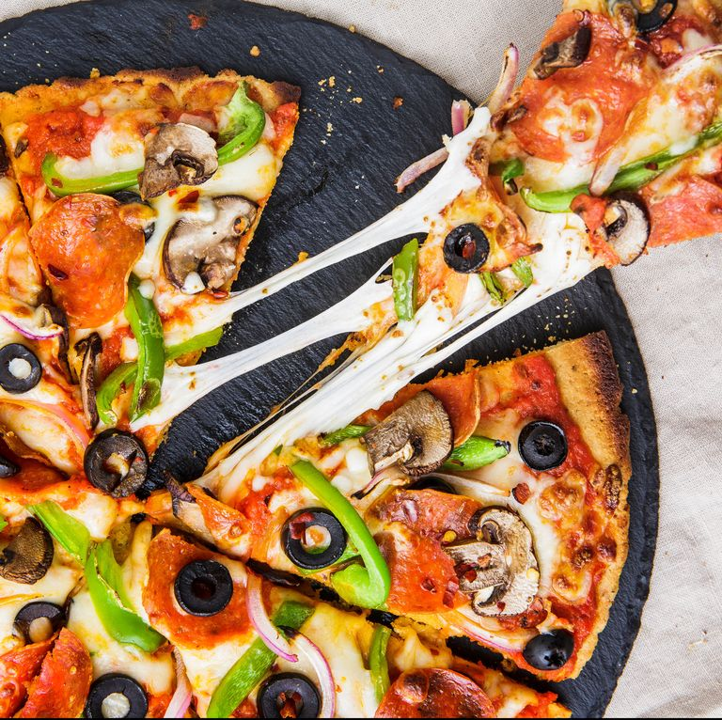
Which major city has the greatest choice of pizza places in the US?

Slide 2

How to find which city will have the greatest choice of pizza places in a city in the US

Slide 3

Possible destinations:
New York, NY
San Francisco, CA
Jersey City, NJ
Boston, MA
Chicago, IL.

Slide 4
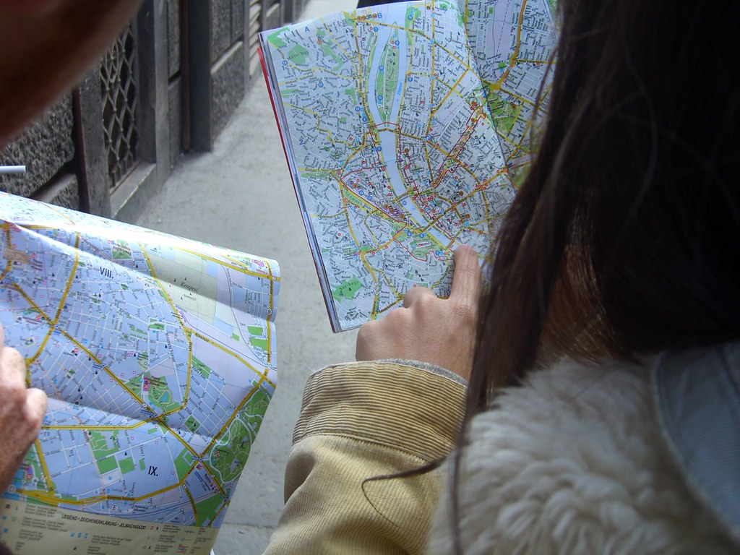
Let’s see how the maps of the cities with the pizza places looks like

Slide 5
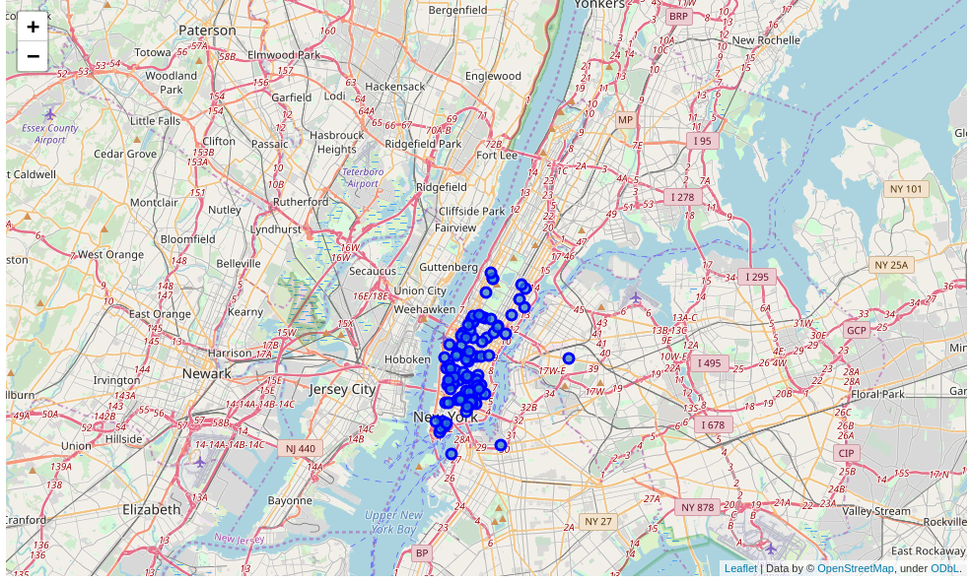
New York

Slide 6
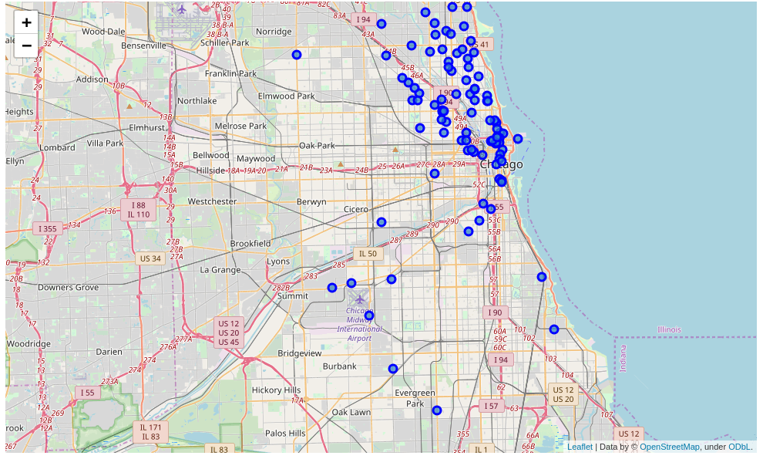
Chicago

Slide 7
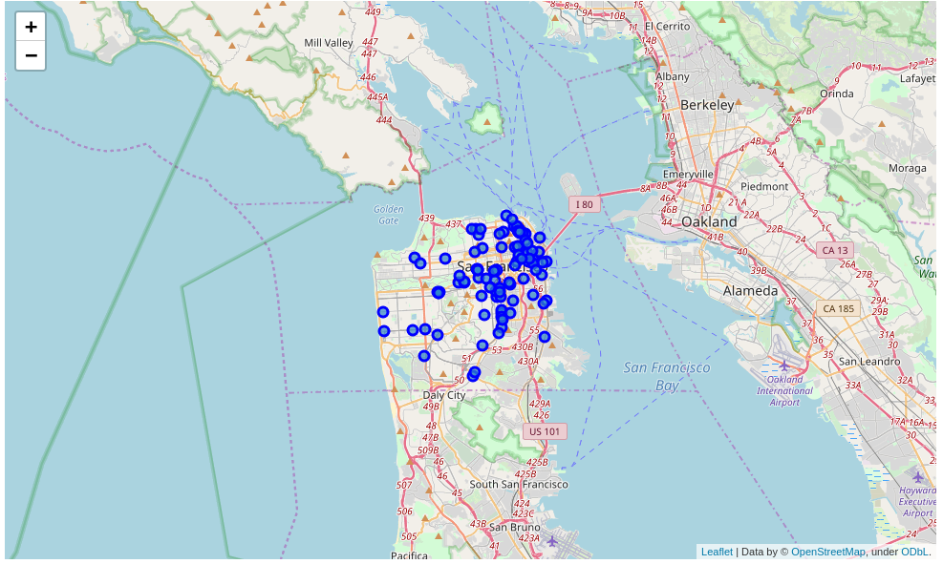
San Francisco

Slide 8
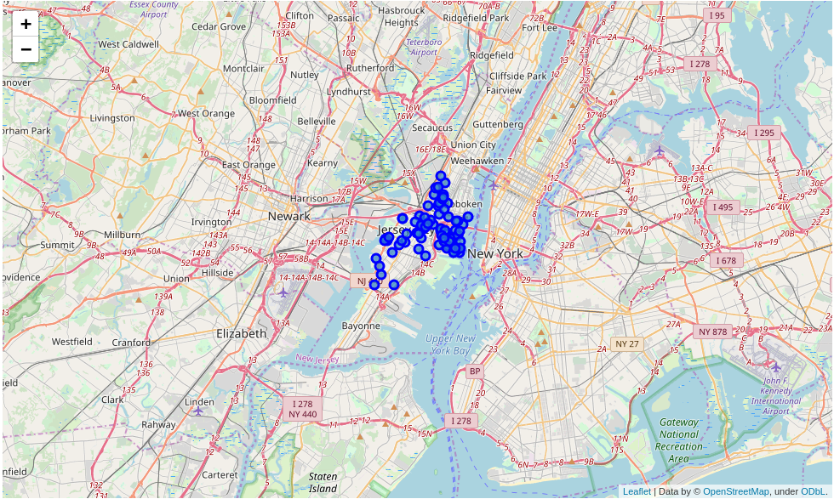
Jersey City

Slide 9
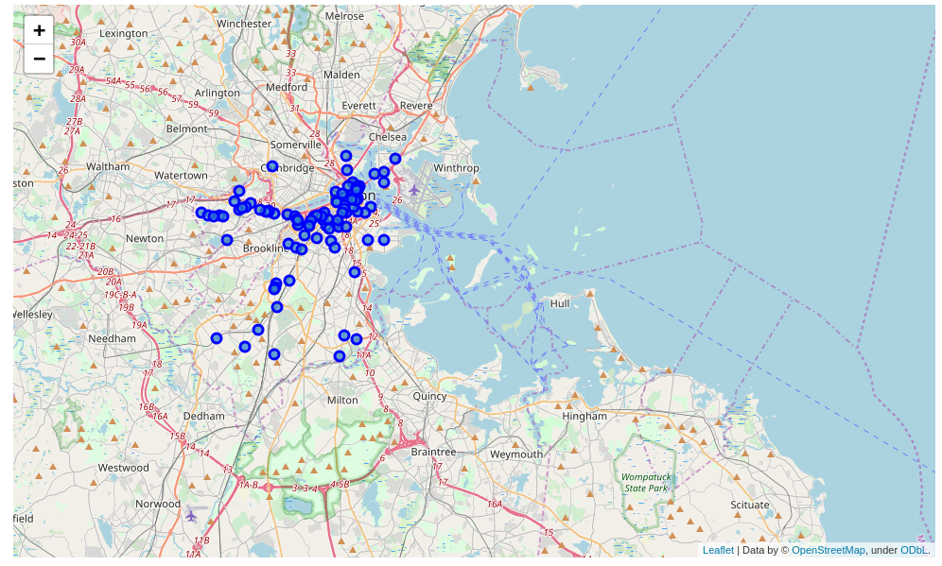
Boston

Slide 10

How to decide:
Calculate the center of all pizza places (green circle)
Calculate distance from each pizza place to the centre
Rank cities according to lowest distances

Slide 11
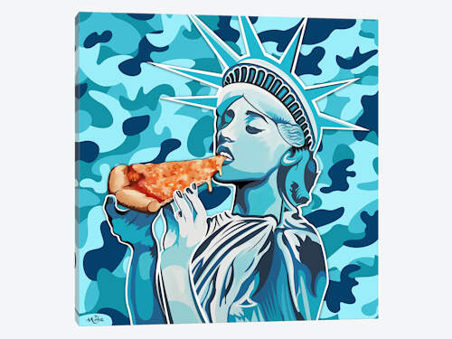
Results
New York
Jersey City
San Francisco
Boston
Chicago

